Slide 1

Sets
Presented by:
Elizer Ponio Jr.
Department of Computer Science
College of Computing and Information Technologies

Slide 2
Outline
Introduction and Definition
Set Notations
Set Builder Notation

Slide 3

Set
A set is an unordered collection of distinct objects, which are called elements
Sets are often drawn with curly braces enclosing their elements.
$$A=\{1, 2, 3\}$$
Name of the set
List of elements

Slide 4
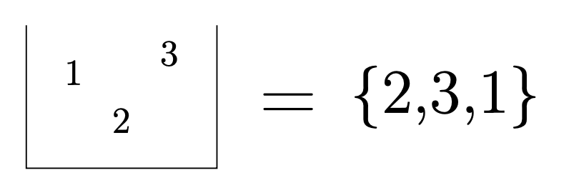
Set
Another way to think about a set is as a box, possibly with some things inside.
When you look into a box, the things inside do not have any particular order; the same can be said about the elements of a set.

Slide 5
Set
The above box also corresponds to {1,2,3}, {1,3,2}, {2,1,3}, {3,2,1} and {3,1,2}.
We will view all of these sets as being equal to each other, since they contain the exactly the same elements.
For example, {1, 3, 2} = {3, 2, 1}

Slide 6
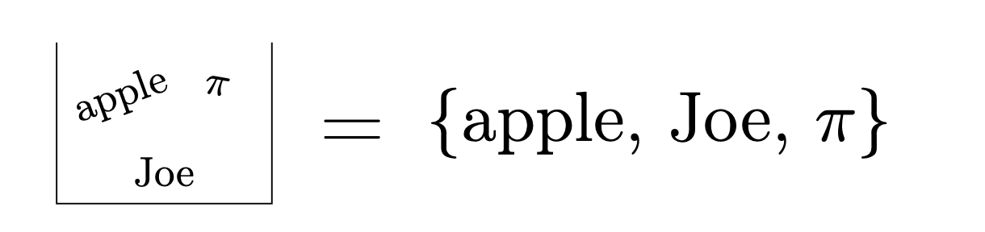
Set
Another important thing to note about sets is that the elements do not have to be numbers. The elements of a set can be anything.

Slide 7
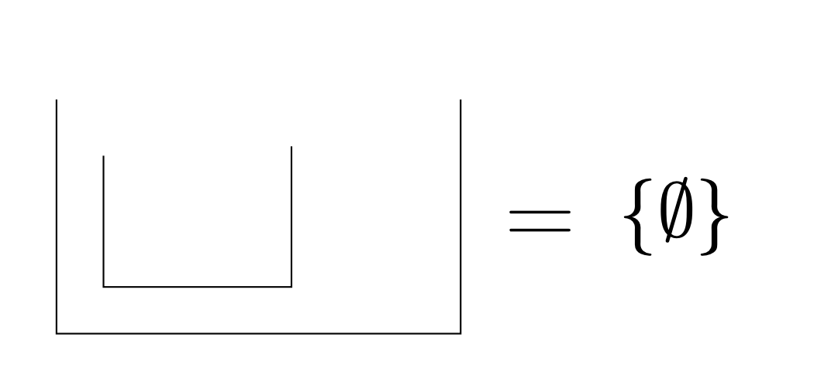
Set
Just as boxes can be empty, so can sets!

Slide 8
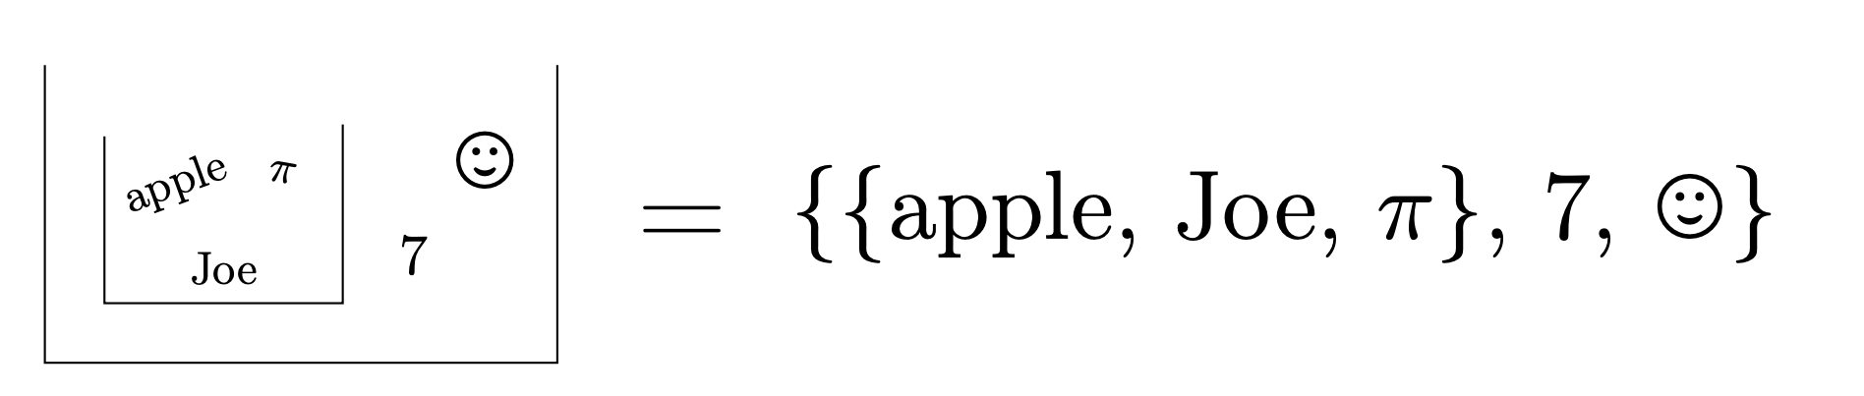
Set
Furthermore, it’s certainly possible for one box to be inside another box.
Likewise, it’s certainly possible for one set to be a single element inside another set.

Slide 9
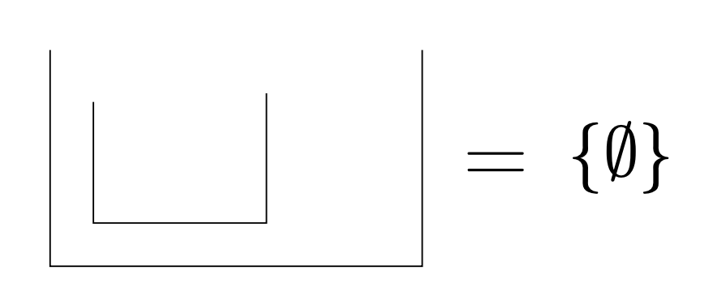
Set
Your box could also have just one thing in it: a smaller box with nothing inside it. This looks like the following.

Slide 10
Set
Your box could also have just one thing in it: a smaller box with nothing inside it. This looks like the following.

Slide 11
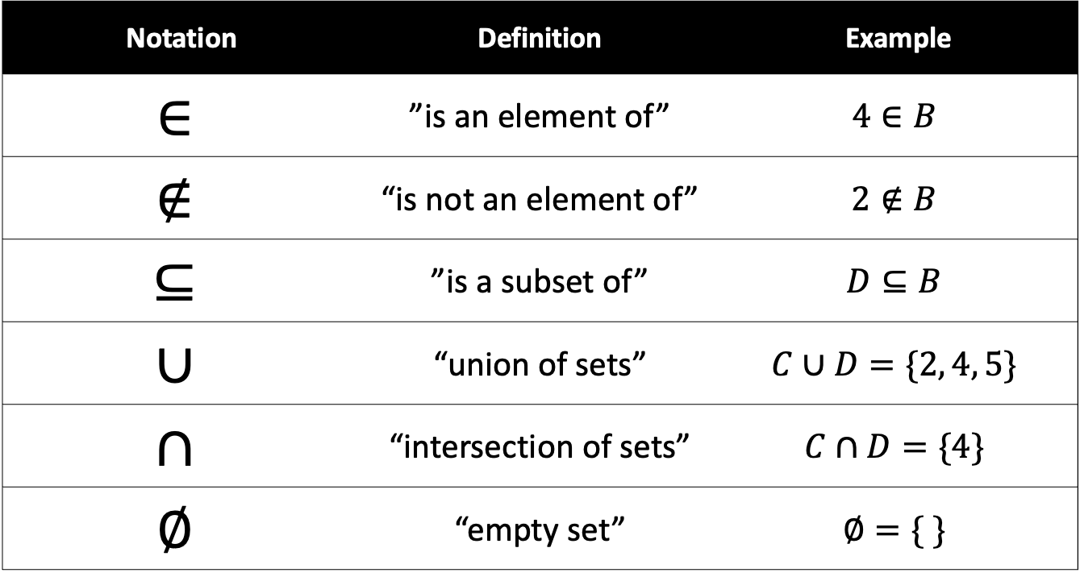
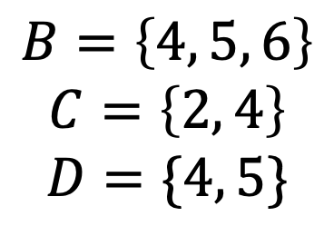
Set Notations
For example, given these three sets
Notation | Definition | Example
$$∈$$ | ”is an element of” | $$4∈B$$
$$∉$$ | “is not an element of” | $$2∉B$$
$$⊆$$ | ”is a subset of” | $$D⊆B$$
$$∪$$ | “union of sets” | $$C∪D=\{2, 4, 5\}$$
$$∩$$ | “intersection of sets” | $$C∩D=\{4\}$$
$$∅$$ | “empty set” | $$∅=\{ \}$$
$$B=\left\{4, 5, 6\right\}$$
$$C=\left\{2, 4\right\}$$
$$D=\{4, 5\}$$

Slide 12
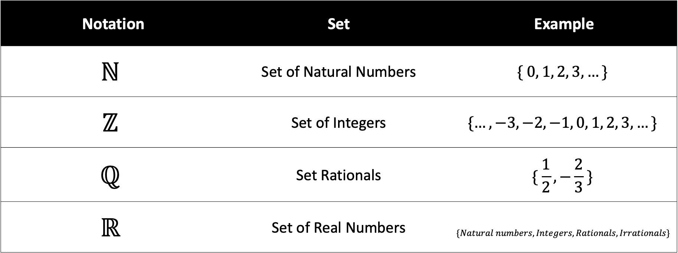
Important Sets
Notation | Set | Example
$$ℕ$$ | Set of Natural Numbers | $$\{ 0, 1, 2, 3,…\}$$
$$ℤ$$ | Set of Integers | $$\{…, −3, −2, −1, 0, 1, 2, 3, …\}$$
$$ℚ$$ | Set Rationals | $$\{ \frac{1}{2},−\frac{2}{3} \}$$
$$ℝ$$ | Set of Real Numbers | $$\{Natural numbers, Integers, Rationals, Irrationals\}$$

Slide 13
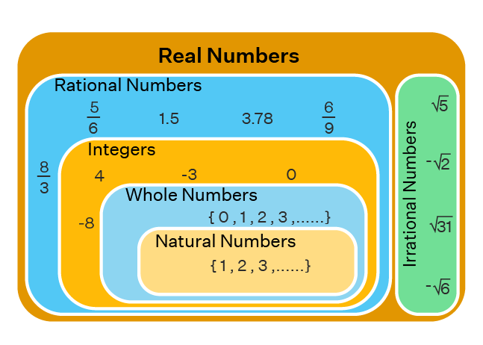
Important Sets

Slide 14
Set Builder Notation
A set-builder notation is used to describe sets that are too big or complex to list between braces.
A set-builder notation is used to describe a set by saying what properties its members have.
Using this notation, we can "build" a set by describing what is in it.

Slide 15
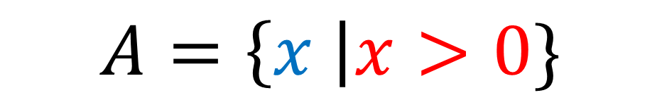

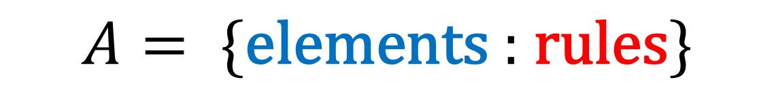
Set Builder Notation
In general, a set A written with set-builder notation has the syntax
$$A= \{\text{elements}\text{ : }\text{rules}\}$$
For example,
$$A=\{x:x>0\}$$
Some writers use a bar instead of a colon
$$A=\left\{x \right|x>0\}$$

Slide 16

Set Builder Notation
$$A=\{x∈ℤ :x^{2}<6\}$$
“Such that”
Name of the set
Description of the set

Slide 17
Set Builder Notation
$$A=\{x∈ℤ :x^{2}<6\}$$
Where I am taking my
elements from
Extra constraints

Slide 18
Reading a Set Notation
$$A=\{x∈ℤ :x^{2}<6\}$$
A
is the set
integer numbers x
such that
x squared is less than 6
There are only 5 integers whose squared value is less than 6, therefore $A=\{−2, −1, 0 , 1, 2\}$

Slide 19

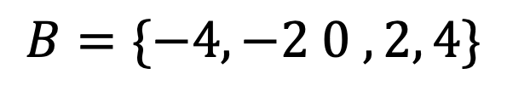

Reading a Set Notation
$$Given set A=\{−2, −1, 0, 1, 2\}$$
$$B=\{2x :x∈A\}$$
B
is the set
of elements in the form 2x
such that
x is an element of A
Therefore,
$$B=\{−4, −2 0 , 2, 4\}$$

